Slide 1
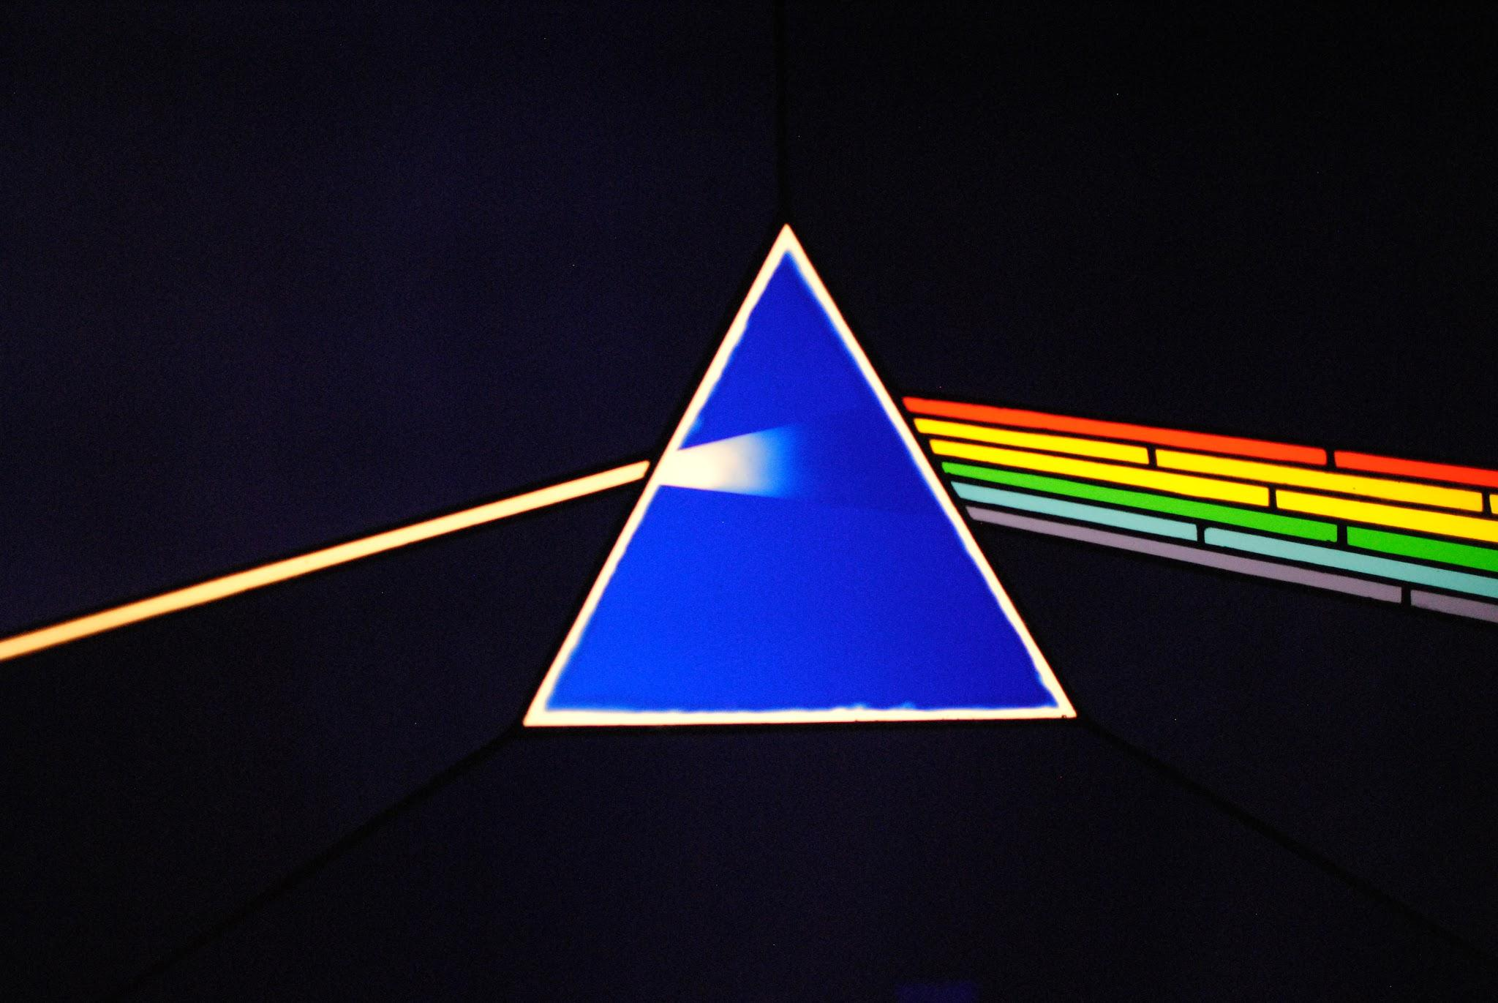
Nashville Rock-and-Roll Marathon and Half-Marathon Race Results (2016 - 2019)
Pink Floyd

Slide 2
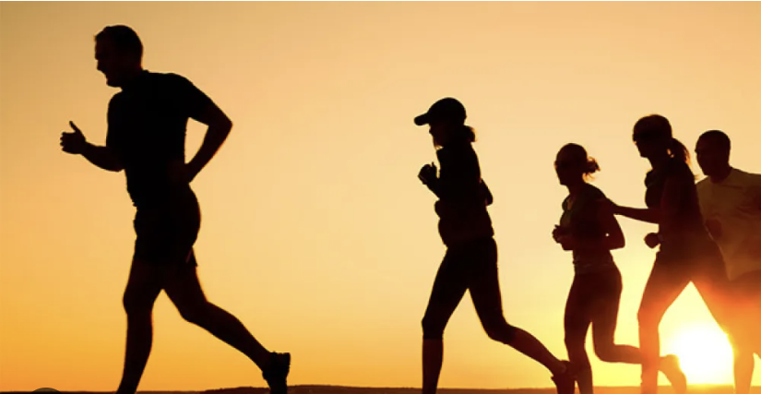
Objectives
Fastest and Slowest time for each race
Beating Oprah's Time
Quartiles
% of runners each race that beat Oprah’s time
Hypothesized Reason for the slower year
Time difference b/w 1st & 2nd position each year.

Slide 3
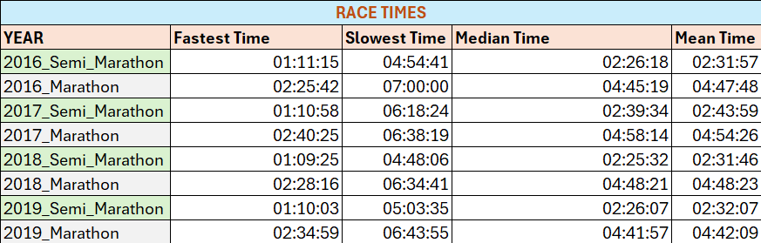
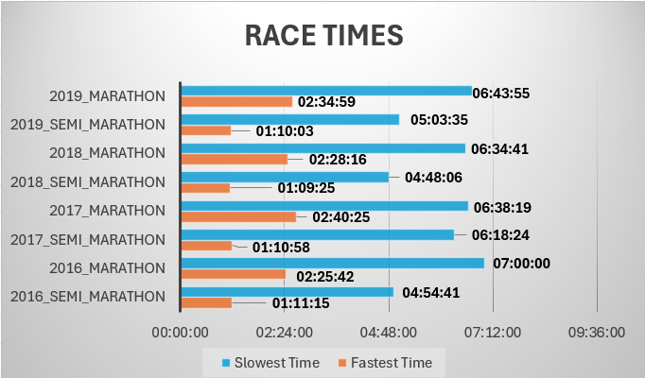
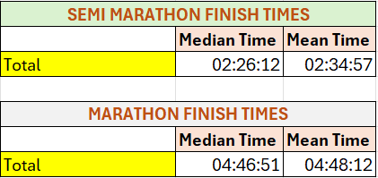
SLOW AGAINST FAST TIMES
Fastest Time: Semi & Marathon 2018
Slowest Time: Semi 2017, 2016 Marathon

Slide 4
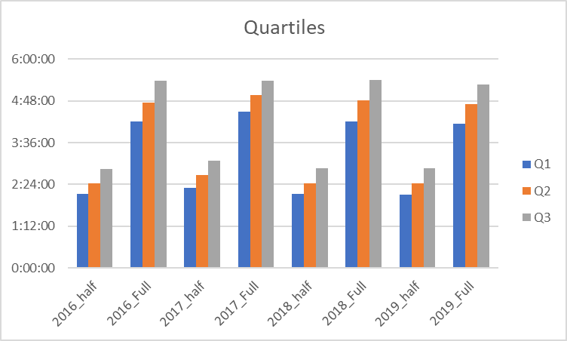
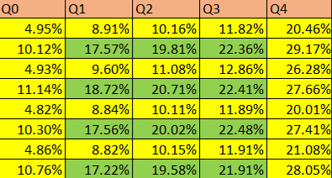
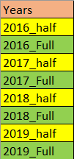
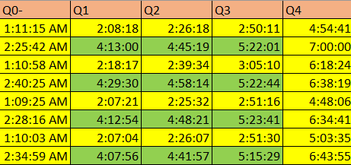
Quartiles

Slide 5
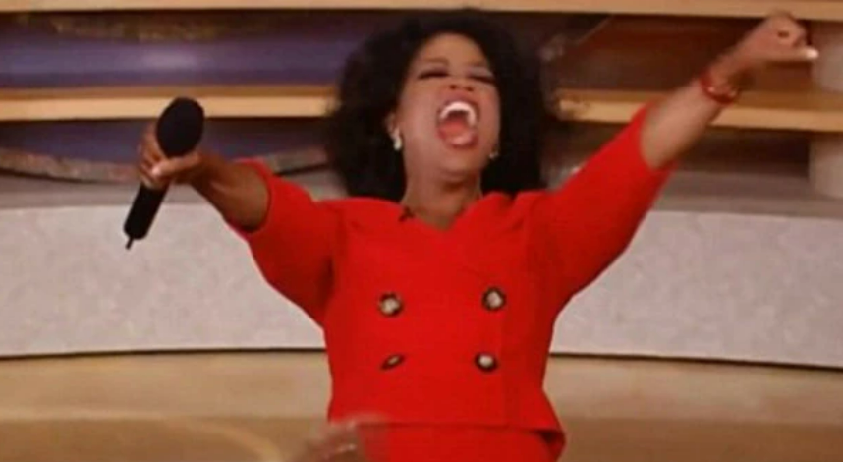
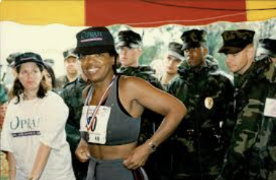
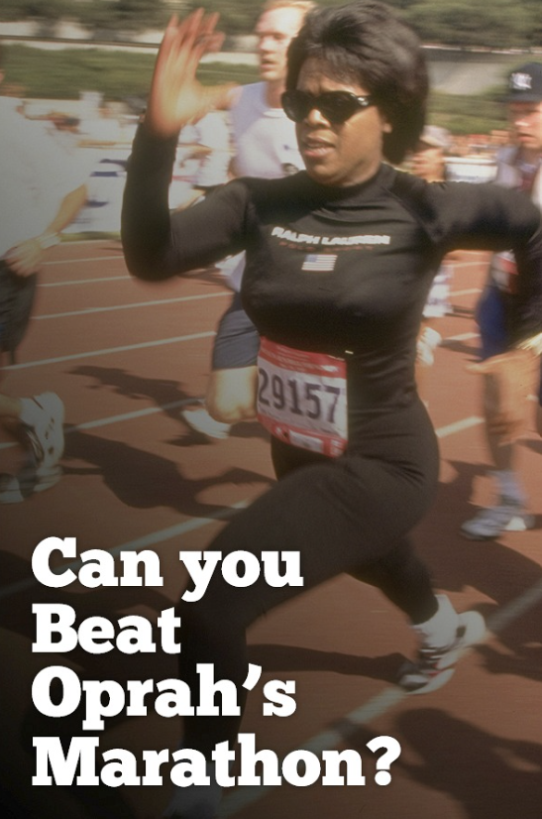
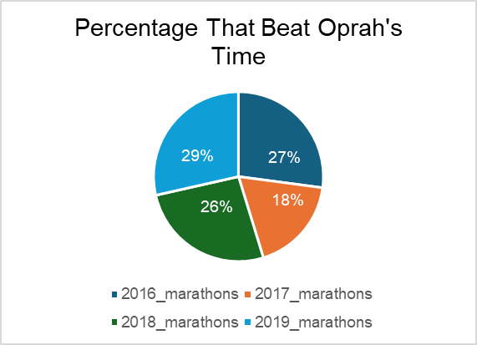
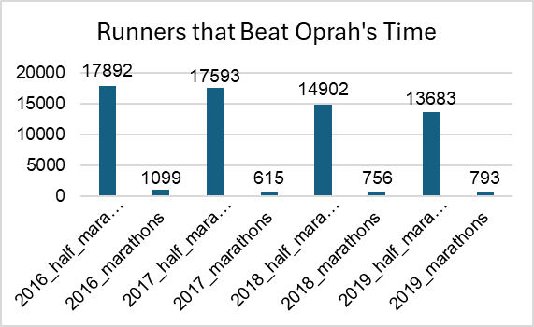
Beating Oprah’s Time

Slide 6
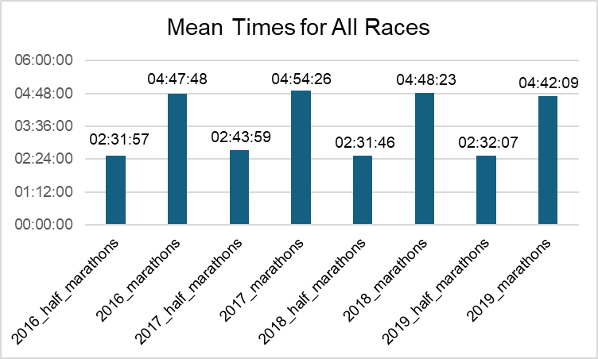

Reasons Runners Might Be Slower or Faster
There are several reasons why a runner's time might change from year to year. Here are some examples:
Temperature
In 2017, April experienced unusually warm temperatures
Runners Experience
How long an individual has been running
How many races they have competed in
Training/Conditioning
Modifications to a training plan can have an impact on a runner’s ability to become faster
Nutritional Changes could have contributed to a runner's energy levels which could enhance their overall performance
The runner could have obtained a personal trainer to help improve overall performance
Technology (i.e., apple watch, shoe type)
The use of performance tracking technology can aid a runner in seeing where their time could be improved
This graph shows the comparison between all mean times from 2016-2019

Slide 7
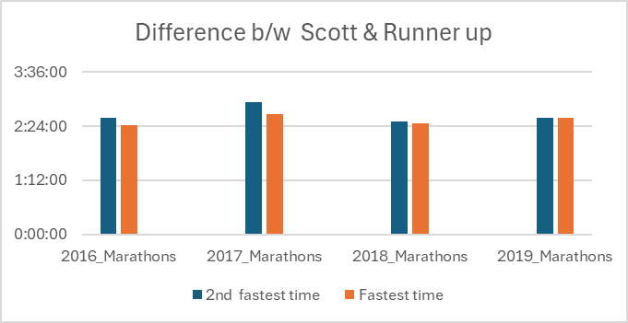
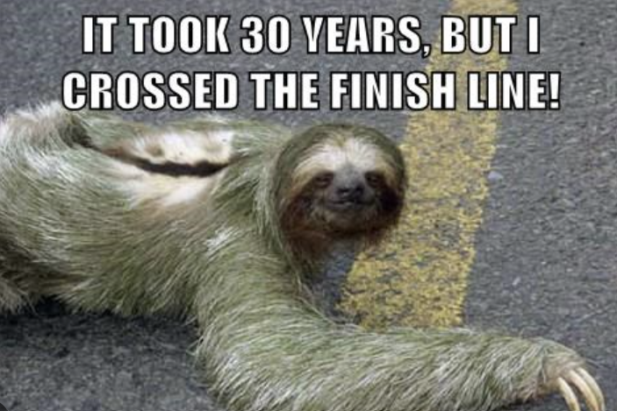
Higher Bar Means slower Time
2017 was an off year, more time was taken to finish than the other years
2019 was the underdog year, Scott had a close rival by “25sec”
Scott is getting older, getting slower, but still winning!

Slide 8


